Slide 1
Serverless apps with .NET Core and macOS
Jeff Hollan
Principal PM Manager – Azure Serverless

Slide 2


What is serverless?
Full abstraction of servers
Developers can just focus on their code—there are no distractions around server management, capacity planning, or availability.
Instant, event-driven scalability
Application components react to events and triggers in near real-time with virtually unlimited scalability; compute resources are used as needed.
Pay-per-use
Only pay for what you use: billing is typically calculated on the number of function calls, code execution time, and memory used.

Slide 3
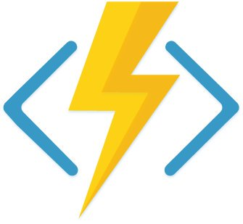
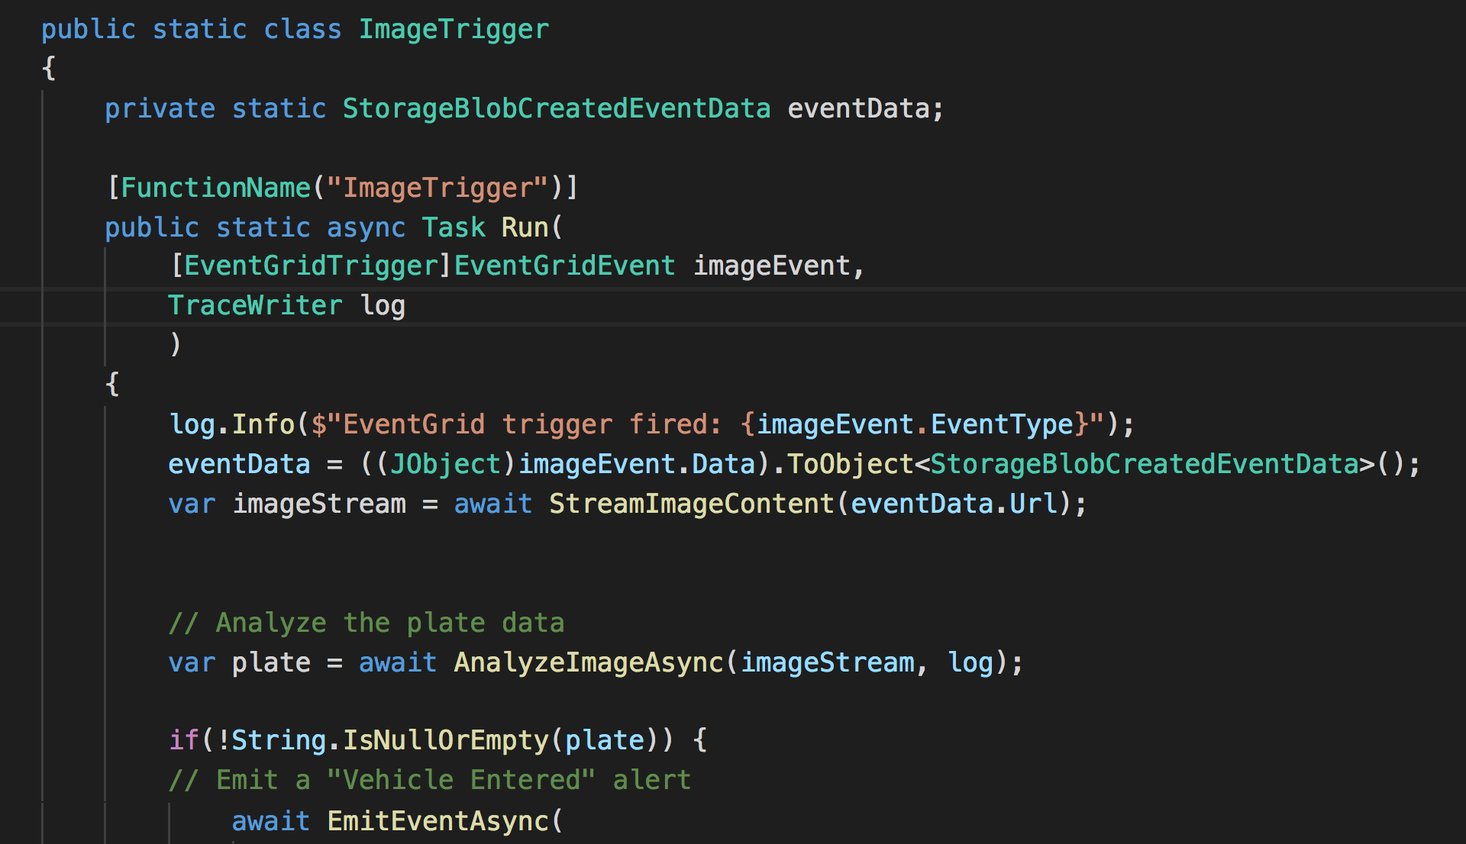
Azure Functions
Deploy code, the rest is managed for you
C#, PowerShell, JavaScript, Java, and Python
Rich tooling and local debugging
Visual Studio, VS Code, Portal, IntellJ, Eclipse, and more
Observability and monitoring
Trigger on dozens of event sources
HTTP
Queues
Event Hub
IoT Hub
Notes:
Domain Specific Language

Slide 4





Modern application pattern
Mobile backend
GitHub + Azure DevOps
iOS
Android
Azure Cosmos DB
Web
API Management
Azure Functions
Social
Table Storage
Notes:
DLB

Slide 5


Modern application pattern
Serverless event processing
CI/CD
Events
Write
Devices
Event Hubs
Function App
Cosmos DB
Azure Pipelines
End-to-end monitoring
Dead letter messages
Storage queue
Monitor
Notes:
https://docs.microsoft.com/en-us/azure/architecture/reference-architectures/serverless/event-processing

Slide 6

Modern application pattern
Serverless web application
Static content
Static website hosting
CI/CD
HTTP GET
CDN
Storage blob
Azure Pipelines
Single-page web application
API
End-to-end monitoring
HTTP GET (AJAX request)
API Management
Function App
Cosmos DB
Monitor
Sign-in
Authentication
Azure Active Directory
Notes:
https://docs.microsoft.com/en-us/azure/architecture/reference-architectures/serverless/web-app

Slide 7
Serverless on macOS
Create an app
Test it locally
Deploy it to Azure
Monitor it

Slide 8
Thanks!
http://aka.ms/functions
https://aka.ms/vs/mac/download
@AzureFunctions
@jeffhollan

Slide 9


Boost development efficiency
Trigger object
Your code
Input object
Input Binding
Output object
Trigger
Output Binding
Notes:
There is a lot of code you can save thanks to the Functions programming model based on triggers and bindings, as this code to connect to different services (either for trigger data and input/output operations) is done by the platform, improving your development time as you don’t lose a minute on connections code that tend to be reused a lot of times.
See the full list of services with Triggers and bindings – https://docs.microsoft.com/en-us/azure/azure-functions/functions-triggers-bindings

Slide 10
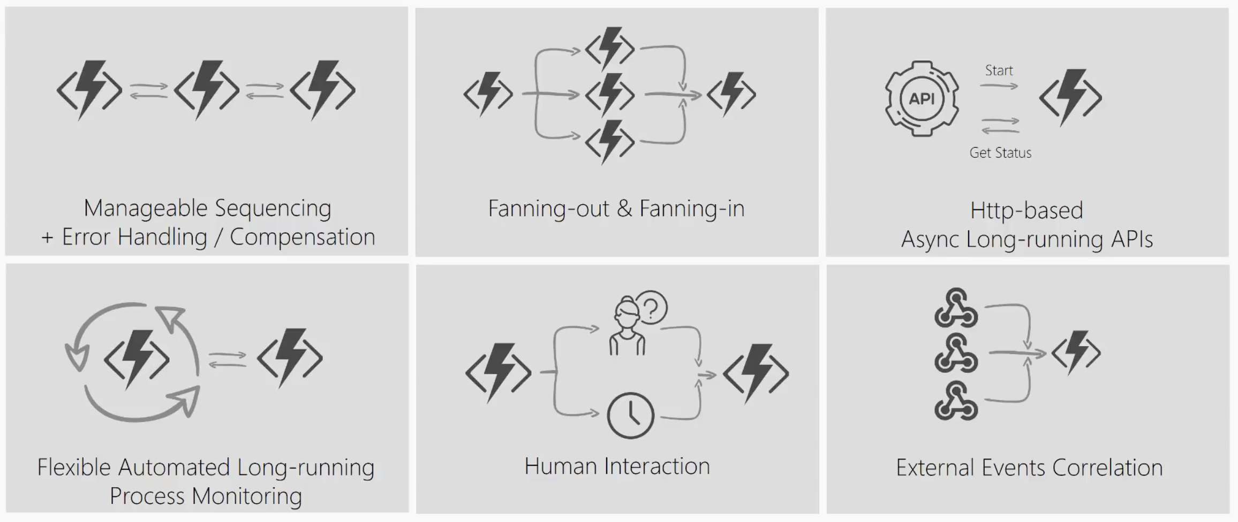
Durable Functions Patterns
Notes:
Imagine a scenario where I have to take the output of a Function and use it as the input to call another Function. I’ll have to coordinate the chaining manually.
If I have to have a function that takes some sort of event and then parallelizes it into multiple Functions, I can still do that but how will I know when all Functions have finished executing so I can aggregate the results and move on.
What if I had to listen on multiple events and aggregate their outcome to determine which specific job or function to run in my application.
What if I wanted to do some kind of extended monitoring on an endpoint? For example, if I were to monitor the temperature of a remote machine and take action x if the temperature were lower than a certain threshold, else do y or run job y.
What if I have an API or endpoint that was running for a long time? I know Functions are short-lived but sometimes you guys put some serious load on them. Could there be a mechanism to provide status of the execution back to the client so they’re not left hanging?
And lastly, what if I wanted to get some sort of human interaction in there? For example, if I am to do some sort of 2FA in the middle of my function execution but also don’t want to wait forever because sometimes people take forever to reply especially when the texts are automated.
Today, I’m going to be talking about some of these problems – how you can approach them in regular FaaS? And how they can be simplified with the technology of Durable Functions.

Slide 11
What It Looks Like
Orchestrator Function
// calls functions in sequence
public static async Task<object> Run(DurableOrchestrationContext ctx)
{
try
{
var x = await ctx.CallFunctionAsync("F1");
var y = await ctx.CallFunctionAsync("F2", x);
return await ctx.CallFunctionAsync("F3", y);
}
catch (Exception)
{
// global error handling/compensation goes here
}
}
Activity Functions
Notes:
> So in Durable Functions, we introduce the concept of “an orchestrator" that will orchestrate or manage what happens between rest of the Functions.
> It is responsible for calling and receiving output from activity functions that you’re familiar with as regular functions. When an activity returns, it return value becomes part of the local state of the orchestrator function so you’re able to work with it as any other variable in that block of code.
> CallFunctionAsync uses queues under the covers, thus they can be scaled out to multiple VMs.
The other thing is that if I want to have exceptions in my code, say something goes wrong in a particular function, I can do that. We’re all familiar with the syntax and now we can do it in a distributed way.
Mention rewind feature to talk about in new developments

